Slide 1

Week 6, Wed.
Today: How does M. Butterfly convey its critique of race and gender roles?
Be studying for Wed. midterm. McBurney students: use the codes to make an appointment
Note paper topics and section leader conference times
John Lithgow and B.D. Wong, M. Butterfly on Broadway, 1988

Slide 2

I. 5 p.9 How does the scene set up Gallimard’s capacity to be duped? Twist: How does the scene work against this?
M. Butterfly
Image: Clive Owen 2017
Audio: John Litthgow, 1988

Slide 3
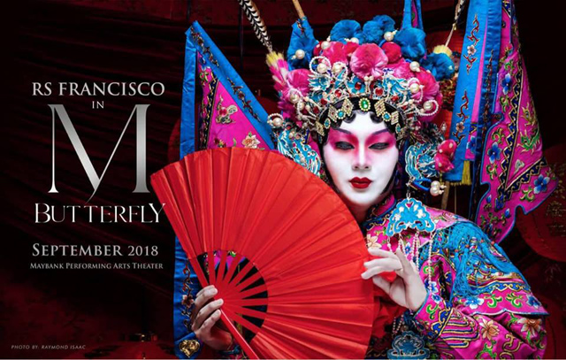
Song: Miss Chin? Why, in the Peking Opera, are women’s roles played by men?
Chin: I don’t know. Maybe a reactionary remnant of male—
Song: No. (Beat). Because only a man knows how a woman is supposed to act.
(emphasis mine, II, vii, 63).
What does this exchange imply about gender as a system?
As an identity?

Slide 4

How does the scene below support or refute the statements below?
Gallimard is in love with the idea of Song..
Song's motivations for deceiving Gallimard are fairly straightforward. Song is “in love with” power, acting, manipulation, his own ego.
Go to: III.2 p. 84
“Yes, you. White man.”
Jin Ha in the revival of M. Butterfly, 2017

Slide 5
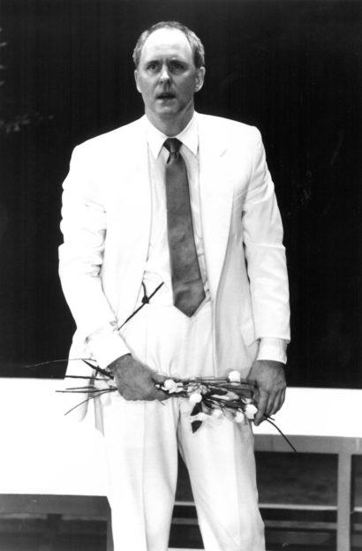
How does the scene below support or refute the statements below?
Once Song's deception is revealed, Gallimard is effectively disempowered.
Go to III.2 p. 88
audio clip: John Lithgow, 1988
M. Butterfly, 1988

Slide 6
II. 2 p. 89
Song: I'm your Butterfly. Beneath everything, it was always me. Now, open your eyes and admit it--you adore me.
G: [H]ow could you, of all people, have made such a mistake? . . . . You showed me your true self. When all I loved was the lie. A perfect lie . . .

Slide 7
Go to: III.2 p. 88
Agree or disagree:
The misconceptions and fantasies that haunt Gallimard’s relationship with Song could happen to anyone.
Agree: To what extent does anyone create what they desire in another person? What is the role of fantasy projection in any romantic relationship?
vs
Disagree: the specificity of Gallimard’s fantasy has a name: Orientalism

Slide 8
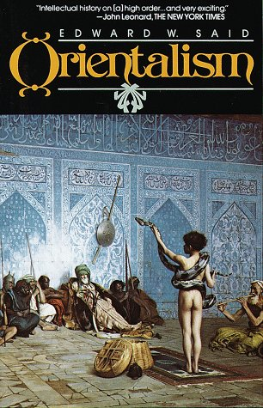
Naming the fantasy of East: Edward Said’s Orientalism
Orientalism represents the “systematic discipline by which European culture was able to manage--and even produce--the Orient politically, sociologically, militarily, ideologically, scientifically, and imaginatively during the post-Enlightenment period. . . .
European culture gained in strength and identity by setting itself off against the Orient as a sort of surrogate and even underground self.” (1978)

